Slide 1



Machine Learning Training
Day 1
Guillaume COTER
R&D Engineer
Worldline Labs – AI Skill Centre
Olivier CAELEN
R&D Researcher
Worldline Labs – AI Skill Centre
Luxin Zhang
R&D Researcher
Worldline Labs – AI Skill Centre

Slide 2
Table of contents
Hello ! ☺
Definitions
Formalism
Machine learning in practice
Introduction to Decision Tree based models
TP2 – Decision Tree and Random Forest
Breaks
11:00 → 11:15
13:00 → 13:30
15:00 → 15:15

Slide 3

Hello !
let's introduce ourselves

Slide 4
Definitions

Slide 5
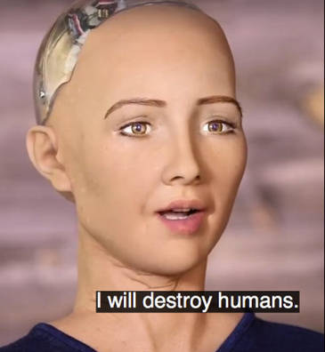
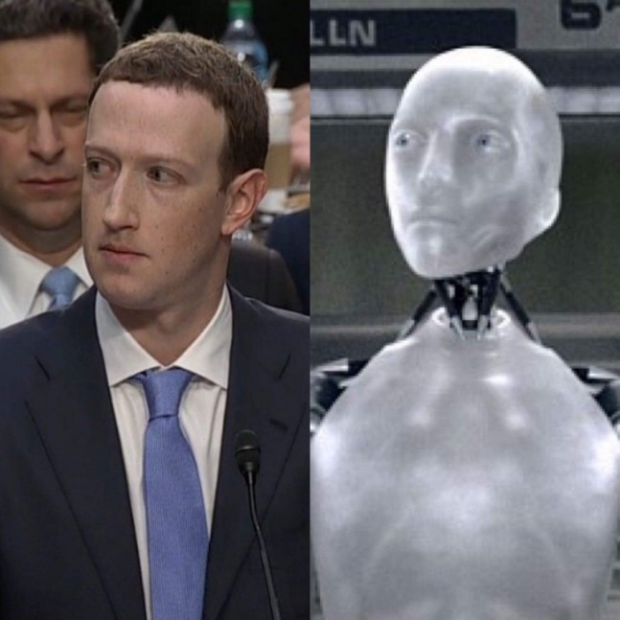
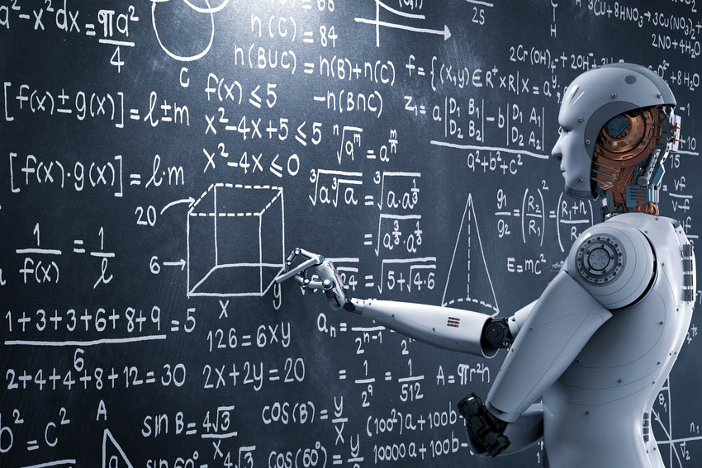

What is artificial intelligence ?
Any technique that allows the computer to imitate human behavior
Brut-force AI (infeasible when the decision space is too high)
Rule-based AI; e.g., expert system
AI with learning
AI for strategy-games
e.g., Age of empires II AI Scripting:
https://gist.github.com/mayerwin/ac4a5ec62f51e94a3fa9
Credit: Civilization - FIRAXIS GAMES / 2K GAMES
This training focused on these techniques

Slide 6
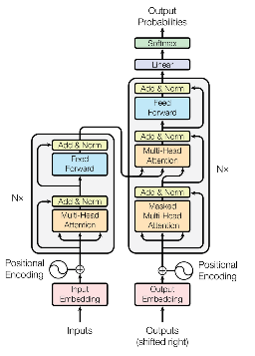
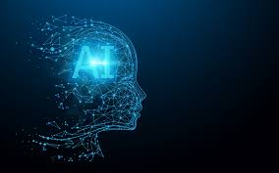
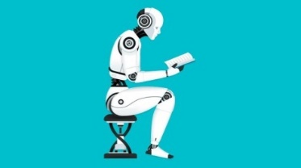
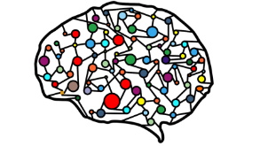
What are AI, ML and DL ?
Artificial
Intelligence
Machine
Learning
Deep learning
Any technique that allows the computer to imitate human behavior
Transformers
Ability to learn without being explicitly programmed
Models for sequence-to-sequence tasks using attention mechanisms
Extract patterns from data using artificial neural networks
Most of LLMs (like GPT are here)

Slide 7
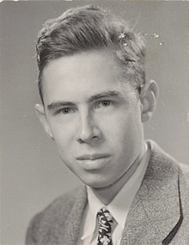
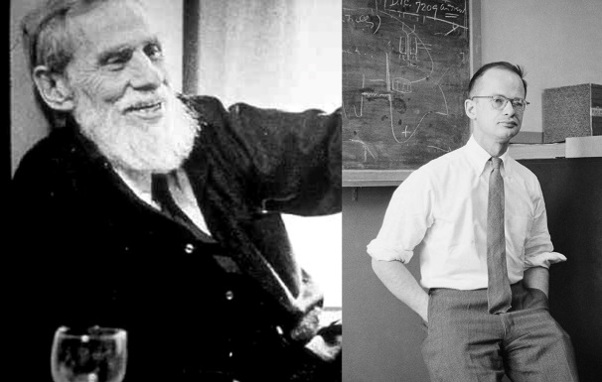
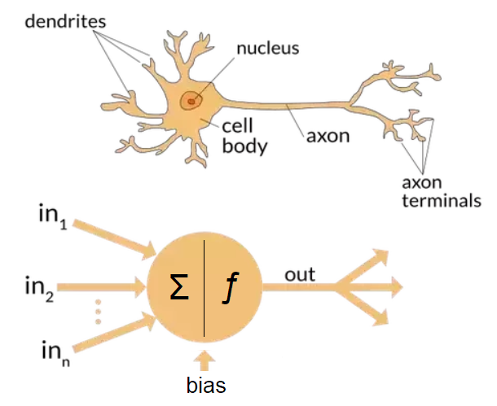
HISTORY: A first ARTIFICIAL NEURAL NETWORK
Frank
Rosenblatt
McCulloch & Pitts
1943
1958

Slide 8
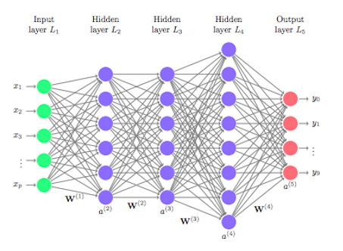
What is deep learning?
Roughly speaking, it’s that :

Slide 9
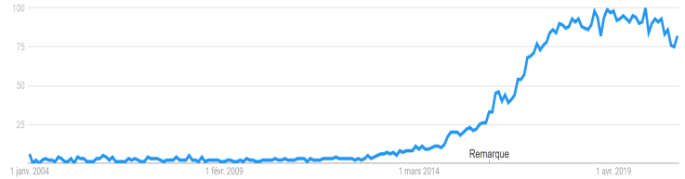
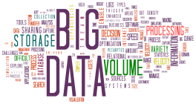
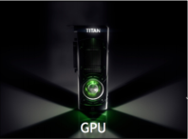
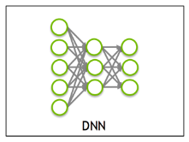
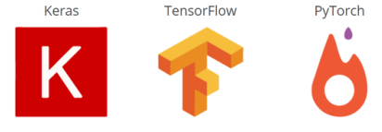
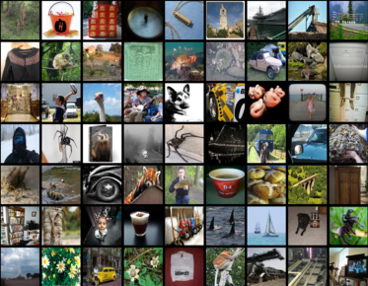
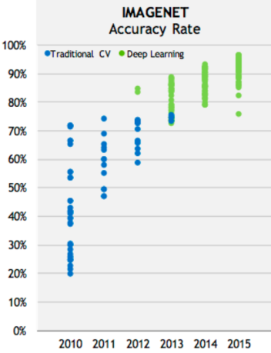

Why deep learning?
Deep learning systems are neural networks
Exist since the 70s (and even before).
What has changed:
more data
new hardware
new algorithms
new software
Google trend ‘deep learning’
14,197,122 indexed images
Some landmarks:
2012: ‘AlexNet’ deep network. Provided 10% increase in accuracy on state of the art image classification (ImageNet)
2015: Classification accuracy of deep learning for images reported to outperform humans
2016: AlphaGo from Google DeepMind outperforms Go world champion
2017-2020: Spectacular progresses in generative models, both in computer vision (GANs) and NLP (Transformers)
2018:Turing award for deep learning

Slide 10
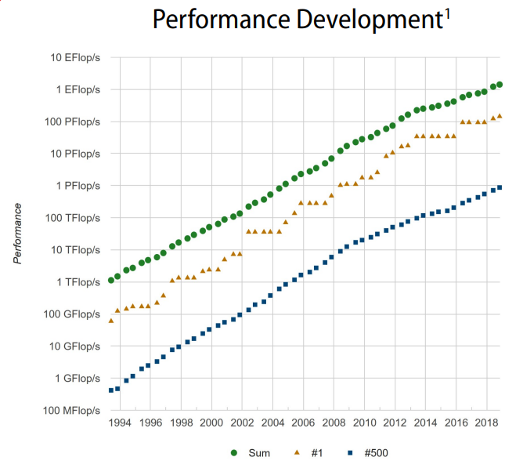
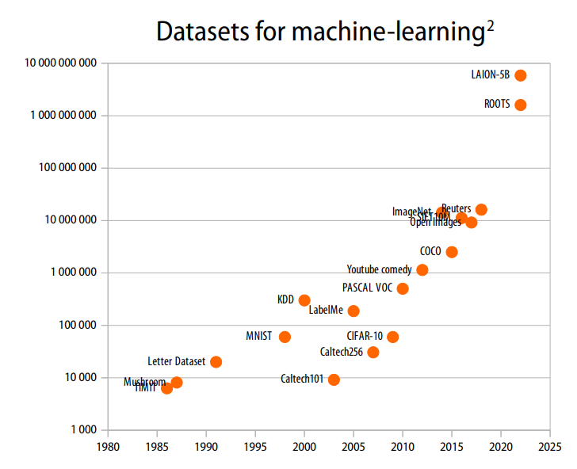
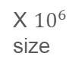
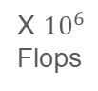
In 25 years
Source: TOP500 List - https://www.top500.org/
Source: Wikipedia
X ${10}^{6}$
Flops
X ${10}^{6}$
size

Slide 11

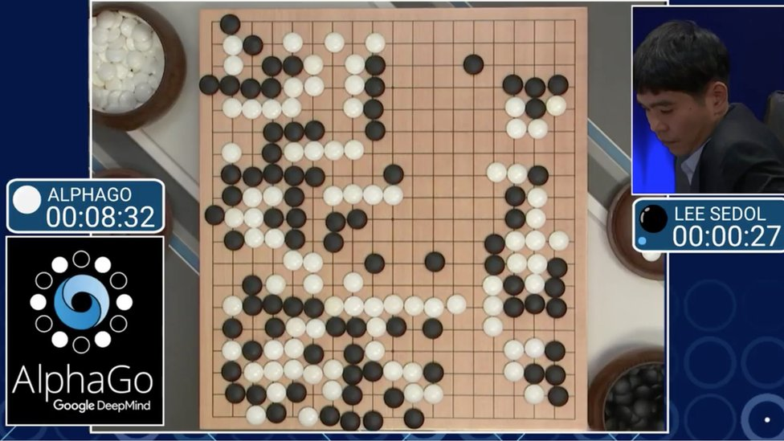
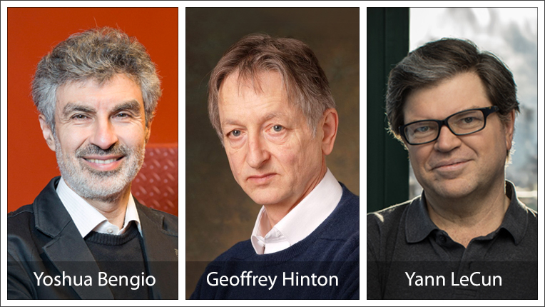
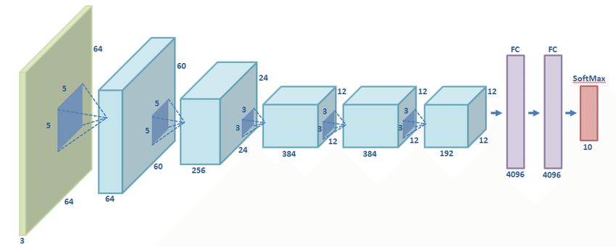
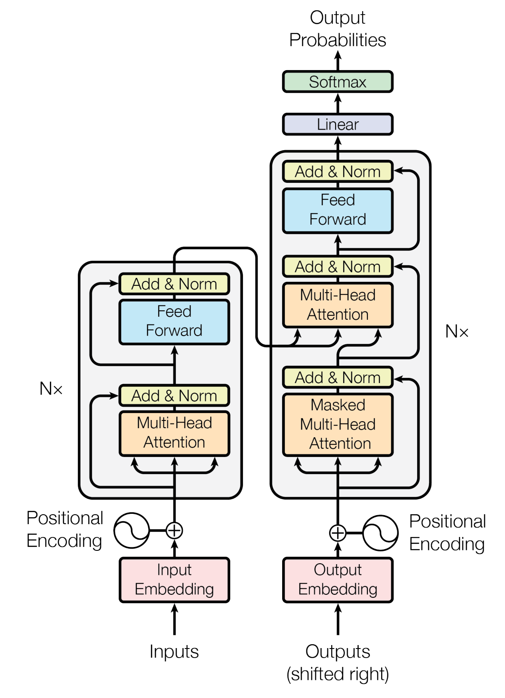
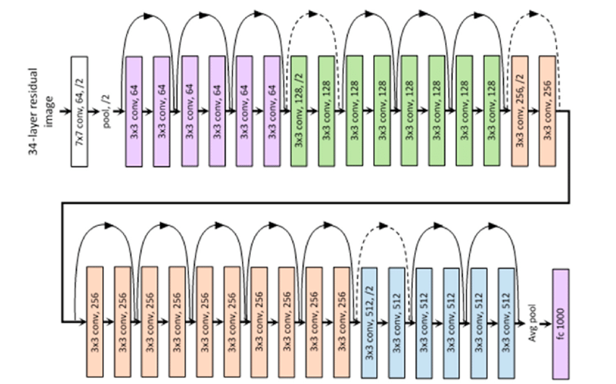
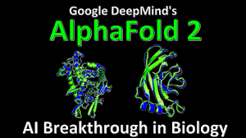
ChatGPT (~GPT 3.5)
Stable Diffusion
Dall-E 2
…
Generative adversarial network (GANs) by Goodfellow et al.
Turing award for deep learning
Bert
GPT-1
AlphaGo outperforms Go world champion
GPT-3
Generative AI
AlexNet
2012
2014
2016
2018
2020
2022
2024
2013
2015
2017
2019
2021
2023
GPT-4
Llama2
Dall-E 3
…
DL on images better than humans
ResNet
AlphaFold2
Dall-E 1
GPT-2
StyleGANs
Paper: Attention is All You Need
Transformers
Variational autoencoder (VAEs) by Kingma & Welling

Slide 12
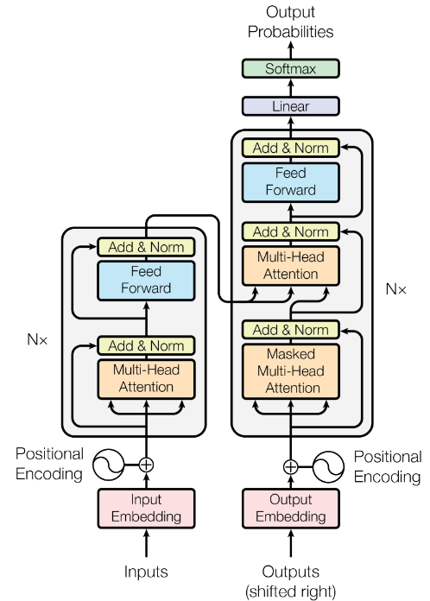
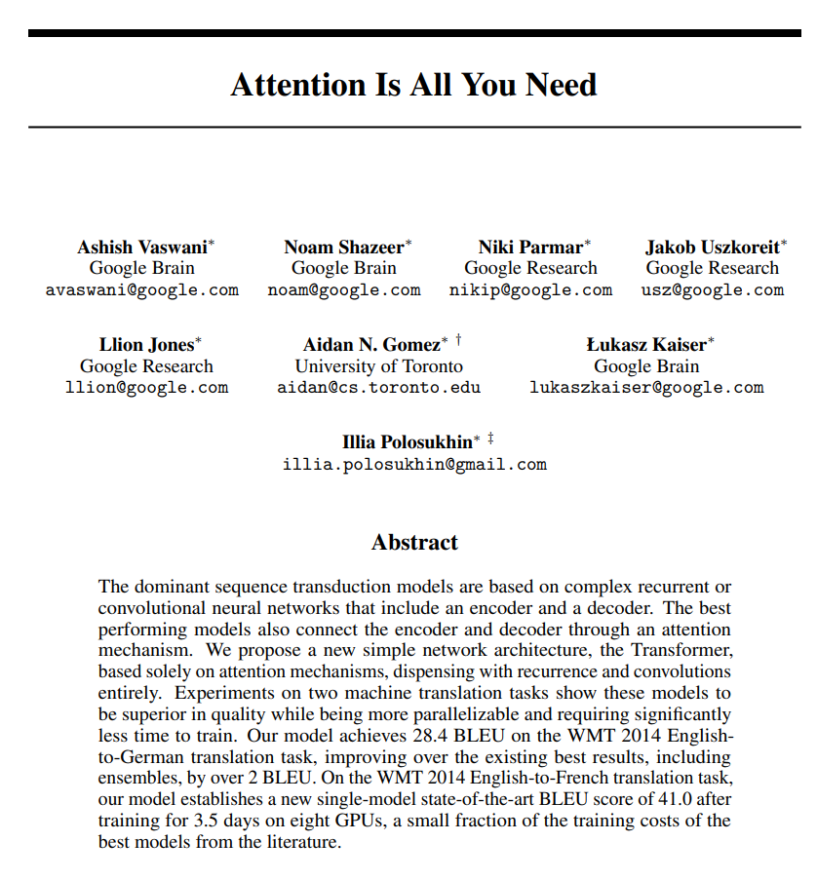
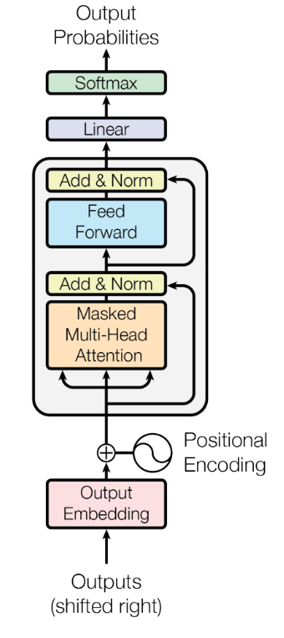
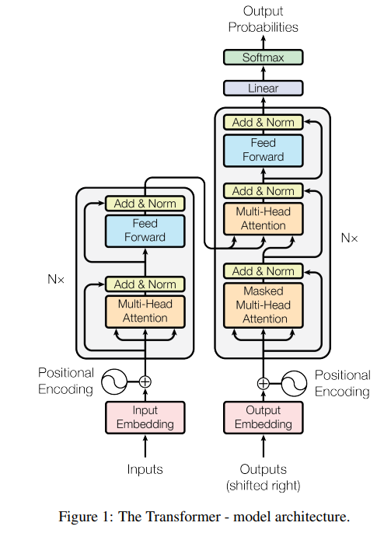
2017: Transformers
GPT
BERT
T5
This paper has been a groundbreaking contribution to the field of AI in recent years.
2018 | GPT-1 | 117 million parameters
2019 | GPT-2 | 1.5 billion parameters
2020 | GPT-3 | 175 billion parameters
2022 | GPT-3.5 (ChatGPT) | 175 billion parameters
2023 | GPT-4 | 1 trillion parameters

Slide 13
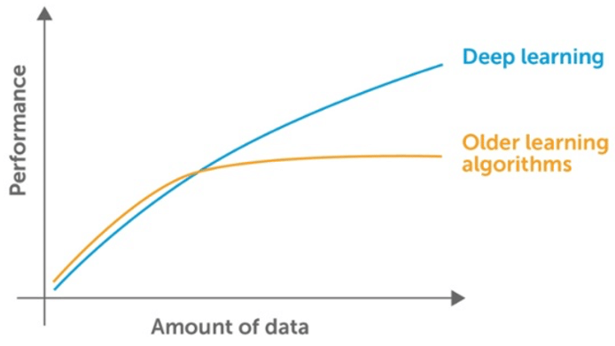
Credit: https://medium.datadriveninvestor.com/when-not-to-use-neural-networks-89fb50622429

Slide 14
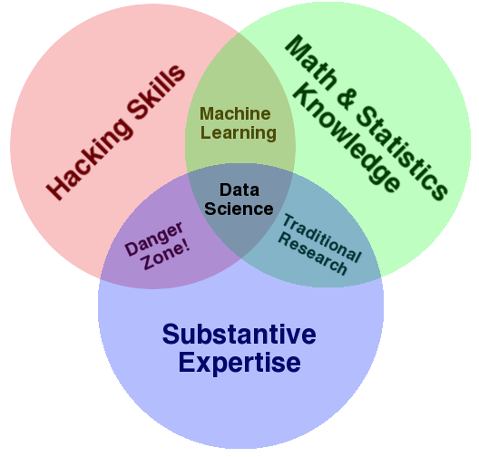

Slide 15
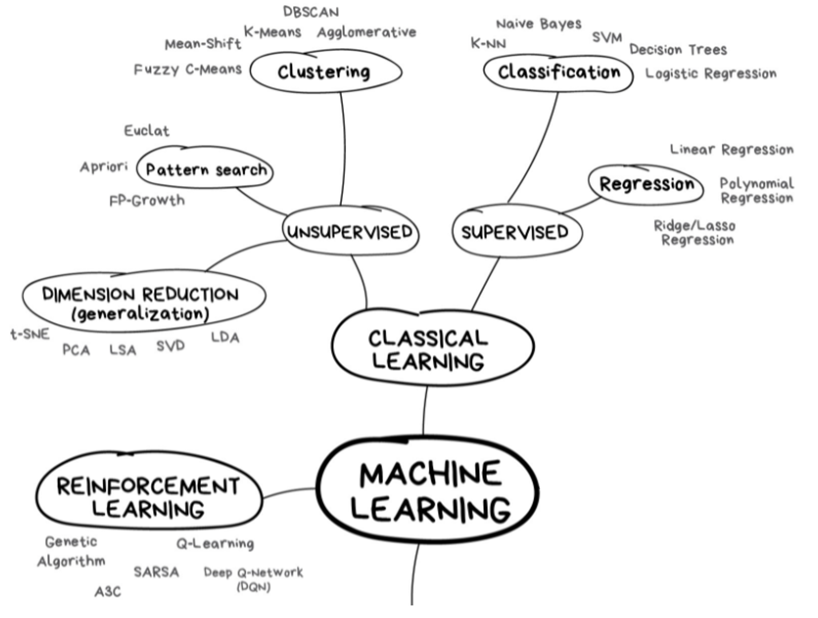

Slide 16
Discriminative AI
Classifying data
Predicting the future
Generative AI
Producing content
Interactive
Fraud Detection
Time Series Forecasting
Chatbot Assistant
Autonomous Agents
Anomaly Detection
Marketing
Behavior based authentication
Media Creation
Automatic summarization
AI for Software Engineering
Recommendation Systems

Slide 17
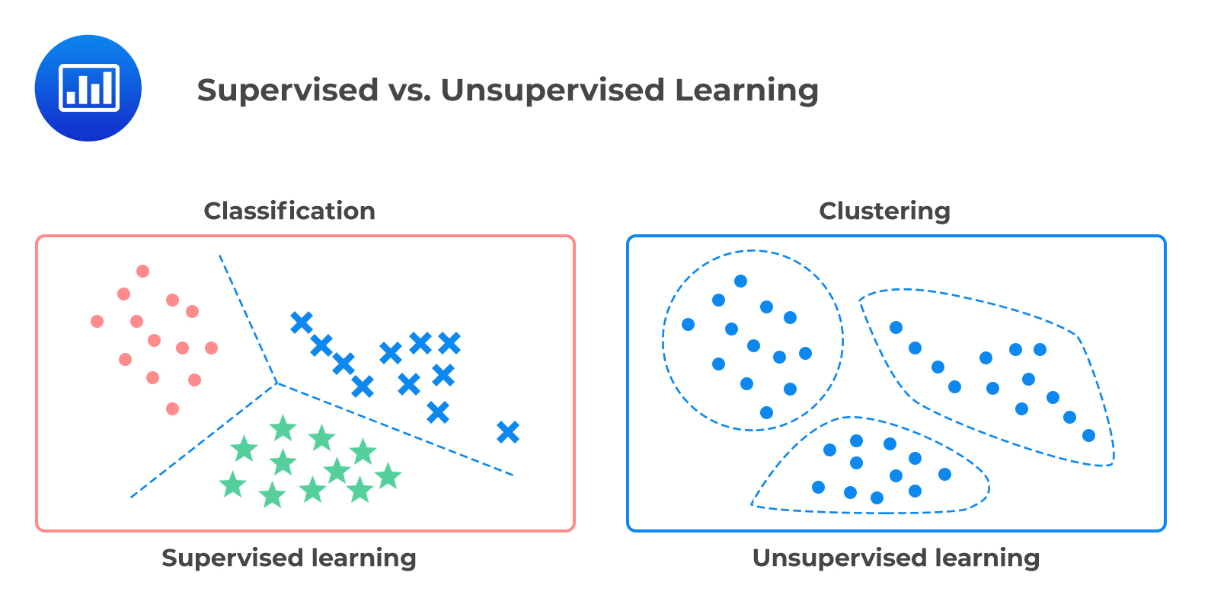
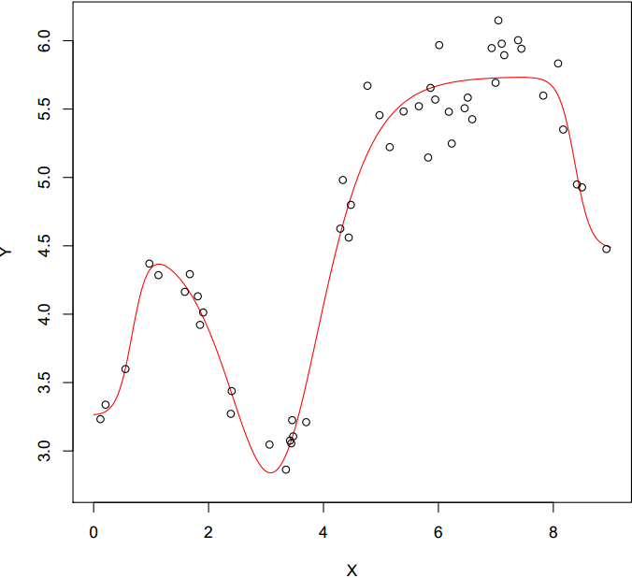
Focus on Discriminative AI
Supervised Learning
Unsupervised Learning
Regression

Slide 18
Focus on Discriminative AI: Supervised vs unsupervised learning

Slide 19
Regression

Slide 20
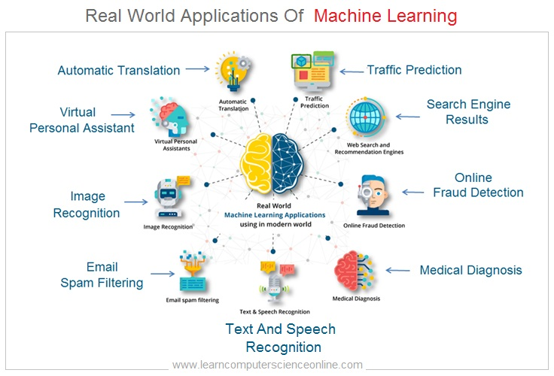

Slide 21
Question for you: Why does an engineer need machine learning?
Let’s brainstorm!
Non-exhaustive list of other engineering application fields:
Maintenance, default detection
Logistics, scheduling, supply chains
Cybersecurity, spamfilter, virus detection
Prediction, e.g.: next word, density distribution, etc.
Classification: signal types, automatic tagging, etc.
Recommendation: social media, marketing, music/film, etc.
Image correction
Smart house
...

Slide 22
What is Machine Learning?
Several definitions:
Machine learning is a branch of Artificial Intelligence in which algorithms and techniques are developed to enable the computer to “learn”.
ML is the automatic extraction of information (rules, patterns) from data.
ML is directly related to data mining, statistics, pattern recognition, information retrieval and theoretical informatics.
…
What is the difference between AI and ML?
Artificial Intelligence is the broader concept of machines being able to carry out tasks in a way that we would consider “smart”.
Machine Learning is a current application of AI based around the idea that we should really just be able to give machines access to data and let them learn for themselves.
What exactly is Learning?
“Learning is the human process that allows us to acquire the skills necessary to adapt to the multitude of situations we encounter.” [Japkowicz and Shah (2011)]
In Machine Learning terms, we say: “A computer program is said to learn from experience E with respect to some class of tasks T and performance measure P, if its performance at tasks in T, as measured by P, improves with experience E.” [Mitchell (1997)]

Slide 23
First ‘Formalization’

Slide 24
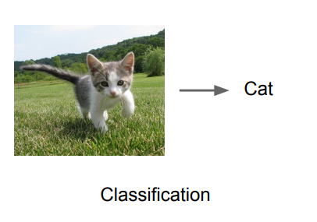
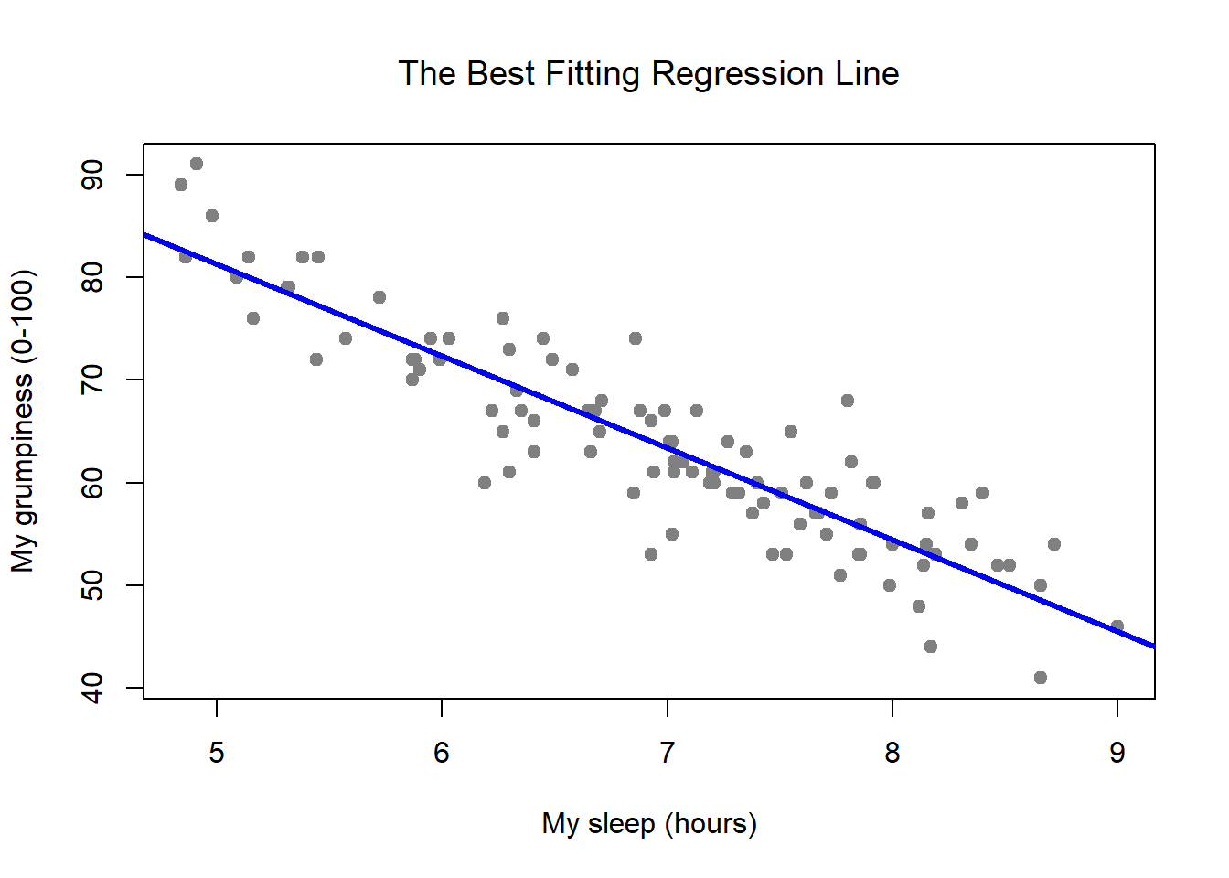
Supervised learning
Learning to predict something
Data:
x = input variable, y = variable to predict
Goal:
Learn the mapping : x -> y
Examples:
Fraud detection
Image classification
Price regression
Regression

Slide 25
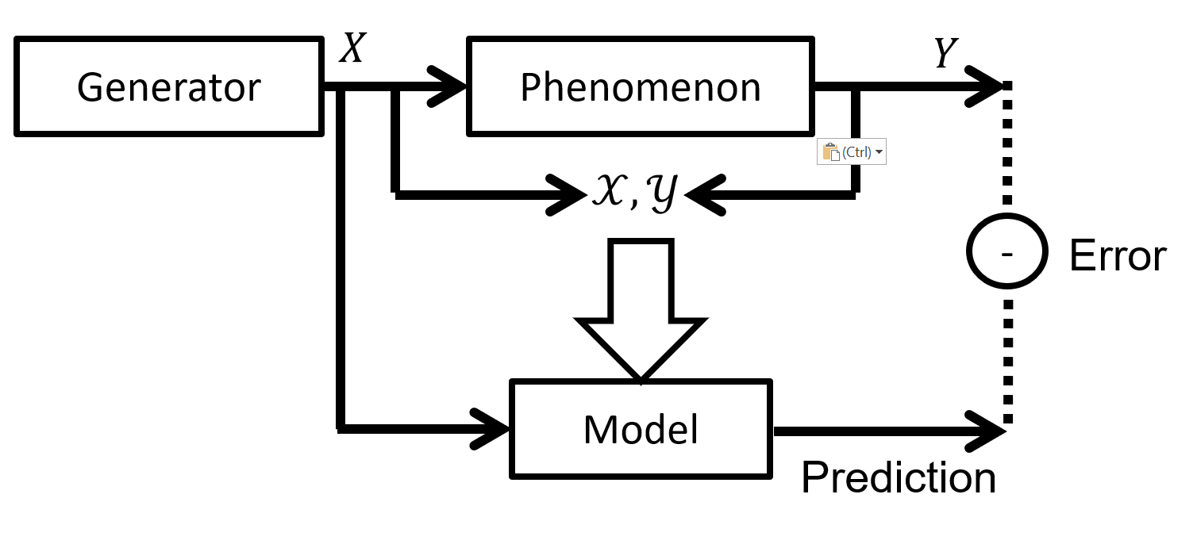
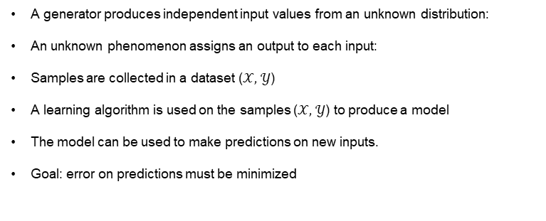
Supervised learning
Actors in supervised learning
Assume that we have a dataset where the lines are observations and columns are variables.
In a supervised learning problem, we have (at least) one variable which is the “target” (output variable).
The other variables are called the input variables
Two types of target variables:
Numeric → regression problem
Nominal → classification problem
In both cases, the dataset is used to produce a model
This model can make predictions of new inputs
A generator produces independent input values from an unknown distribution:
An unknown phenomenon assigns an output to each input:
Samples are collected in a dataset ($𝒳,$ $𝒴$)
A learning algorithm is used on the samples ($𝒳,$ $𝒴$) to produce a model
The model can be used to make predictions on new inputs.
Goal: error on predictions must be minimized
X1 | X2 | Target
1,57 | 0,3 | A
12,3 | 0,98 | A
32,7 | -1,3 | B
1,8 | 0,01 | A
7,5 | 1,1 | B
3,2 | 1,2 | B
1,2 | -0,5 | A
… | … | …
X1 | X2 | Target
1,57 | 0,3 | 4.2
12,3 | 0,98 | 6.8
32,7 | -1,3 | -12.6
1,8 | 0,01 | 42.6
7,5 | 1,1 | 11
3,2 | 1,2 | 0
1,2 | -0,5 | 19.5
… | … | …

Slide 26
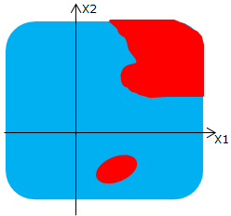
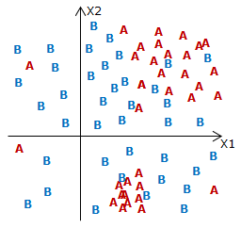
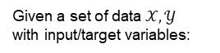
Supervised learning
Given a set of data $𝒳,𝒴$
with input/target variables:
Practical examples:
Bought a certain product?
Repay their loan or not?
Fraudulent transaction?
X1 | X2 | Target
1,57 | 0,3 | A
12,3 | 0,98 | A
32,7 | -1,3 | B
1,8 | 0,01 | A
7,5 | 1,1 | B
3,2 | 1,2 | B
1,2 | -0,5 | A
… | … | …
X
X
Let “X” be a new point, how can I know the best class (“A” or ”B”) of this point?
Via classification algorithms.
The classification algorithm has split the input space in an optimal way.
The new point can now be labeled.
And this result can be used for all new points!
Trees
Logistic regression
Neural Network
…
Think at this same problem in a higher dimension!
It’s a supervised learning problem.

Slide 27
Question for you
Give example of other classification problems applied in you job or in WL in general

Slide 28
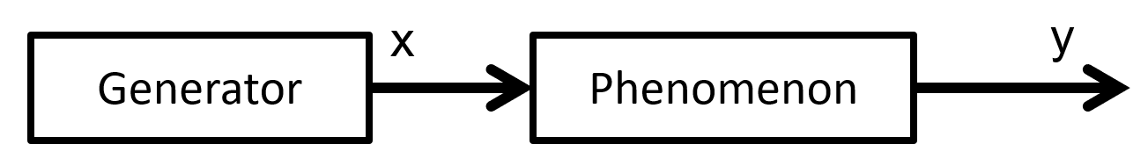
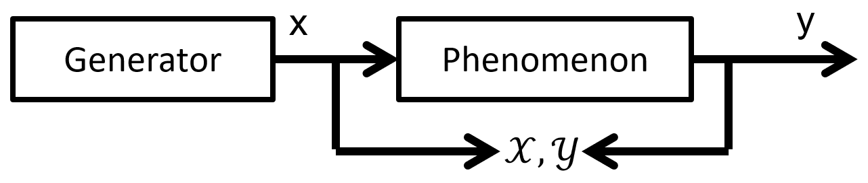
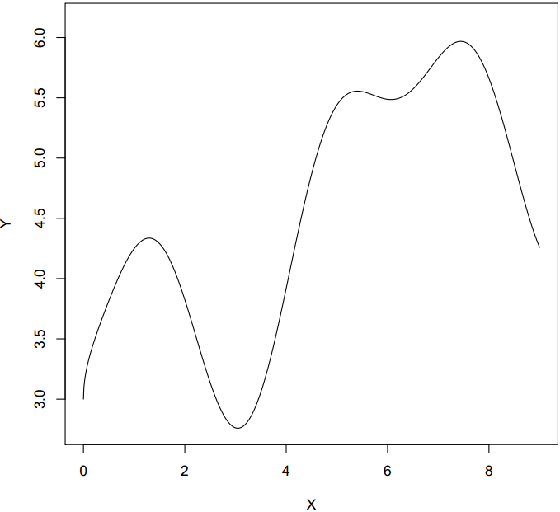
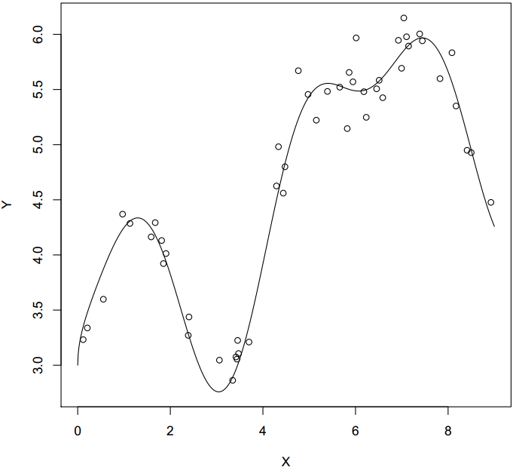
Supervised learning
Regression (I)
Regression (II)
Assume that we have an unknown input/output phenomenon.
Some observations about the unknown phenomenon are available.
There is noise in the data.

Slide 29
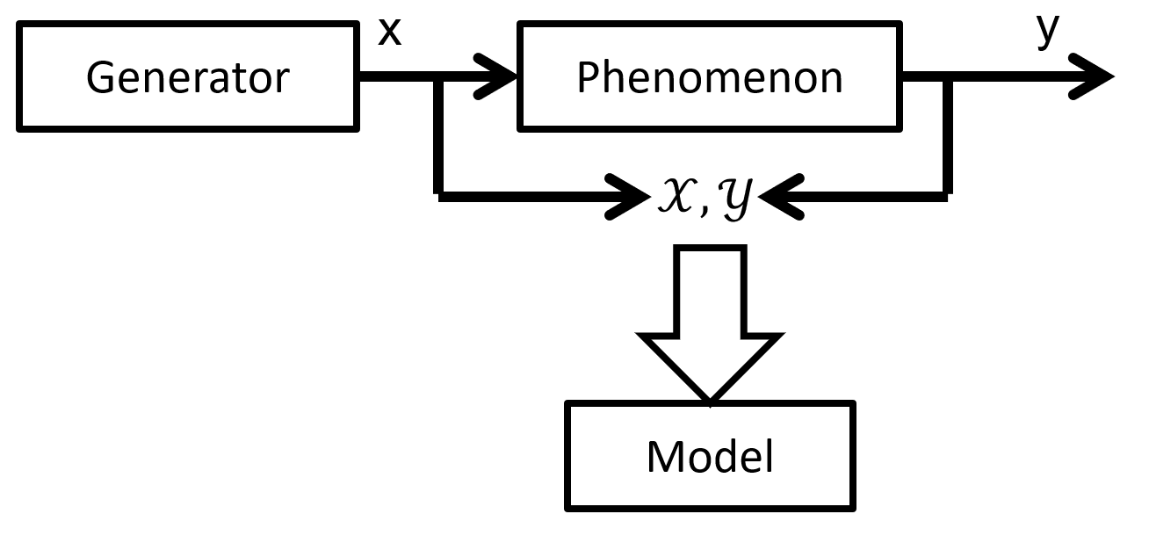

Supervised learning
Regression (III)
Regression (IV)
Phenomenon is unknown!
We only have the samples.
We use a learning algorithm to create a model $h(.,α)$ from the data.

Slide 30

Supervised learning
Regression (V)
The model is an estimation of the true unknown input/output phenomenon.
It makes errors.

Slide 31

Supervised learning
Regression (VI)
The surface in blue measures the error of the model on the input domain.
Without access to the real phenomenon, the goal is to find - based on the available data - the best model which minimizes the blue surface.
Think at this same problem in a higher dimension!

Slide 32
Question for you
Give example of other regression problems applied in you job or in WL in general

Slide 33



Unsupervised learning
X1 | X2 | Target
1,57 | 0,3 | A
12,3 | 0,98 | A
32,7 | -1,3 | B
1,8 | 0,01 | A
7,5 | 1,1 | B
3,2 | 1,2 | B
1,2 | -0,5 | A
… | … | …
No supervision, just analyze and discover
Data:
x = descriptive variables
Goal:
Compress
regroup
learn a hidden structure
…
Examples:
Image compression/denoising
Client segmentation
Detect anomalies

Slide 34

Reinforcement learning
Take actions, get a reward, improve your strategy
Data:
x s = environment state
y a = action to take
a is not given for each s
Reward (negative or positive) sometimes given (after series of actions)
Goal:
Learn the policy Pi : s -> a
Examples:
Learn best strategies in games or other complex environment
Robotics
https://www.youtube.com/watch?v=VMp6pq6_QjI
Reinforcement learning is not covered in this course

Slide 35
Supervised learning in practice

Slide 36



OK, BUT REALLY… HOW ?
Training Data
Predictive Model
$$h(.)$$
Concretely:
data = ($x_{i},y_{i}) i=1,…, N$
→ Training data
The goal is to find a function $h$, such that $h\left(x_{i}\right)=y_{i}$ for all i.
$h\left(x_{i}\right)$ denoted as $\hat{y_{i}}$
In practice, goal is to minimize $L(y_{i},\hat{y_{i}})$
Learning algorithm
Minimize $L(.,.)$
The algorithm will take the training data set as input and will search a function $h()$ (a.k.a. predictive model ) minimizing the loss function $L(.,.)$ computed on the training set.
This definition is not complete and will be updated in some slides!

Slide 37


LINEAR REGRESSION is Machine learning!

Slide 38

Several types of models can be used
Knn,
Naïve Bayes
SVM
…
They all have their advantages depending on the type of problem
Each model type has also hyper parameters to control their “complexity”
Roughly speaking:
applying an overly simple model to a complex problem → underfitting
applying an overly complex model to a simple problem → overfitting
Warning: make the distinguish between a type of model (with its hyperparameters) and a predictive model (with its parameters).

Slide 39



Several types of models can be used
Logistic regression
Decision Tree
Perceptron

Slide 40


Underfitting & overfitting
The dot points are the training data
Question for you:
do you have any idea how to avoid overfitting?
This function minimize $L(y_{i},\hat{y_{i}})$ !
→ trying to minimize the error on the training set is therefore not a “sufficient” criterion.

Slide 41

Full dataset
Learning is a nested optimization task.
The train set is used to ‘compute’ the best parameters of the model.
After the training, the validation set is used to evaluate if the predictive model do underfitting or overfitting.
We check that the complexity is neither too large nor too small.

Slide 42

Data set → training and validation sets
Meta-parameters (a.k.a. complexity)
a.k.a.: complexity

Slide 43
Question for you
What is the difference between a type of model and a predictive model ?

Slide 44
We evaluate a predictive model on data that it has never seen during training → We assess the “generalization” capacity of a prediction model.
Question for you: Do you understand why it is not possible to use the training set to assess the generalization capacity of a predictive model?
Answer: Because the parameters (e.g., the weights) of the predictive model have been optimized to minimize the error on this training set.
The error of the model on the training set is therefore optimistic with respect to the generalization error.

Slide 45

k fold cross validation
Train
Validation
Question for you:
What is the value of k in this example?
What is the maximum value of k?
Do you understand that here we no longer evaluate the generalization error of a prediction model, but we evaluate the generalization error of something related to the “type of model with a given complexity”!!

Slide 46


Optimal complexity selection (aka model selection)
There are several ways to do model selection, but the easiest and most common way is to compare the generalization error of different complexities and select the one with the smallest error.
This can be done by cross-validation or simple validation
Complexity 1
Complexity 2
Complexity N
…
$$error_{1}$$
$$error_{2}$$
$$error_{N}$$
$i_{best}$ = Best complexity = $\text{arg} \min_{i}{error_{i}}$

Slide 47


Final predictive model
$i_{best}$ is the optimal complexity computed on the validation set.
It is common to then use the full data set with $i_{best}$ to build the final predictive model.
Full dataset
with $i_{best}$
The final predictive model
Question for you: Do you understand why it is not possible to use the validation set to assess the generalization capacity of this predictive model?
Answer: The hyper parameters have been optimized to minimize the error on the validation set.
We can no longer say that this validation error measures the error of the model on a dataset that it has never seen
Question for you: do you have any idea of how to measure the generalization error of the final predictive model?

Slide 48
Train, validation and test splits
Full dataset
You cannot touch this test set at any time during learning!
To have a correct estimate of the generalization error, we test the predictive model on the test set only at the end, when the final predictive model is built.

Slide 49
Machine Learning in practice

Slide 50
Why is it complicated?
Data Collection
Data Preprocessing
Training and Validation
Inference
Evaluation
Challenges
Training a good model is challenging
Code and data are very deeply linked
Any step in the pipeline can impact dramatically the performance of the model
Each step has its own challenges

Slide 51

Data Collection
Challenges
Getting relevant data is expensive
Need for an exporting process
External data
From simple
Scrapping: is used for extracting data from websites
Internal data: Videos, Images, Documents
To complex
Automatic data generation
Data augmentation (Rotation, Change of color, etc)
Understand data :
Check out data distribution:
Missing features
Monitor possible changes
Clean data :
Remove not relevant data
Keep the data homogenous
Replace missing values (default value, mean value, …)

Slide 52
Data Preprocessing
Challenges
The models require clean and relevant data
We need a bridge between the data and the model
From Simple
Start with simple and interpretable features (country, MCC…)
To Complex
Automatic calculated aggregation
Categorical data:
Data that cannot be compared by standard operation (additions, multiplications, subtractions)
You can have countries, categories, type of cards…
Continuous data:
Data where standard operation can be applied to compare
Amount, Credit card Limit, Seconds since card creation…

Slide 53


Training and Validation
What is to train: It simply means learning (determining) good values for internal weights or parameters from different examples.
Hyperparameters
Are parameter whose value is used to control the learning process:
Maximum depth of a Tree
Number of Trees
Number of layers, Neurons, etc…
Loss / Error: How far an estimated value is from its true value
Metric: Function that is used to judge the performance of your model. Like loss functions, except that the results from evaluating a metric are not used when training the model

Slide 54

Training and Validation
Dataset:
Validation: The process where a trained model is evaluated with a testing data set. The main purpose of using the testing data set is to test the generalization ability of a trained model

Slide 55

Training and Validation
Validation: The process where a trained model is evaluated with a … How do we know if a model is being correctly trained ?
Loss / Error: How far an estimated value is from its true value.

Slide 56


Training and Validation
Overfitting: “The production of an analysis that corresponds too closely or exactly to a particular set of data, and may therefore fail to fit additional data or predict future observations reliably“
Underfitting: “A data model is unable to capture the relationship between the input and output variables accurately, generating a high error rate on both the training set and unseen data”

Slide 57
Inference
Challenges
Training-serving skew : difference between performance during training and performance during usage in production (latency, throughput)
From simple
Without machine learning (rule based/ if else) decisions.
To complex
With machine learning, complying with client and production exigencies

Slide 58

Evaluation
Challenges
It’s important choose a metric corresponding to your domain but…
From Simple
Don’t overthink the choice, choose one that makes sense. Take as many metrics as you can. Start with comprehensible and simple metrics !
To Complex
Specific KPI metric

Slide 59



Evaluation
Confusion Matrix :
Precision : $\frac{TP}{TP+FP}$
How many predicted cats are really cats. When we say it’s a cat we are certain it’s a cat. We may miss some cats saying they are dogs but we are certain that it’s a cat when we say so.
Recall: $\frac{TP}{TP+FN}$
Out of all the real cats how many did we miss? (even if we increase the false alerts)
Accuracy: $\frac{TP+TN}{TP+FN+FP+TN}$
How well is our model doing good predictions out of all the pictures
Ground Truth
 | Negative | Positive
Negative | $$TN$$ | $$FN$$
Positive | $$FP$$ | $$TP$$
Prediction

Slide 60



Evaluation
Precision: $\frac{TP}{TP+FP}$
Recall: $\frac{TP}{TP+FN}$
Accuracy: $\frac{TP+TN}{TP+FN+FP+TN}$
Exercice
We designed a test to detect a given disease
We consider a population of 10 000 persons to evaluate this test
Among these 10 000 persons, 100 have the disease
Here is the confusion matrix:
Compute the following metrics:
Ground Truth
 | Negative | Positive
Negative | 9 800 | 1
Positive | 100 | 99
Prediction
Metric | Value
Precision | 99 / (100 + 99) = 49.75%
Recall | 99 / (1 + 99) = 99%
Accuracy | (9800 + 99) / (9800 + 1 + 100 + 99) = 9899 / 10 000 = 98.99%
Careful with unbalanced datasets!

Slide 61


Evaluation
F-Score: 2.$\frac{precision . recall}{precion+recall}$
A measure that combines precision and recall is the harmonic mean of precision and recall, the traditional F-measure or balanced F-score
PR-AUC:
We change the threshold (value that determines if it’s a positive or negative example) from 1 to 0 and we obtain the precision-recall curve. We then take the area under the curve to estimate how good is our model

Slide 62

The Machine Learning ecosystem Python won
Python Machine Learning
R Machine Learning
Java Machine Learning

Slide 63







Overview of the most popular libraries From traditional Machine Learning to modern Deep Learning
Library | Description | Launched by | Launch Date | License
 | A research-oriented framework for Deep Learning |  | 2016 | BSD 3
 | An industry-oriented framework for Deep Learning |  | 2015 | Apache 2.0
 | Generalist toolbox for Data Science |  | 2007 | BSD 3
 | The GitHub of Machine Learning |  | 2016 | Apache 2.0
Low-level
High-level

Slide 64



















Libraries and tools
Data Visualization
Machine Learning Models
Running Environment
Data Manipulation
MLOps
Classical
Deep Learning

Slide 65
Classification and Regression Trees

Slide 66


Trees - Concepts
Rules are represented by tree diagrams:
Goal : predict an outcome based on a set of rules.
Trees are very transparent and easy to interpret.
Root node
Example: classify a record as “will accept credit card offer” or “will not accept”
Split node
Income | Education | Family | Class
10,57 | 0,3 | 5,1 | 0
122,3 | 0,98 | 6,54 | 0
312,7 | -1,3 | 4,4 | 1
10,8 | 0,01 | 8,5 | 0
70,5 | 1,1 | 1,4 | 1
31,2 | 1,2 | 2,4 | 1
… | … | … | …
Leaf node
A rule might be:
IF (Income > 92.5) AND (Education < 1.5) AND (Family <= 2.5)
THEN Class = 0 (nonacceptor)
Question for you: How many rules are in this tree?

Slide 67
Recursive partitioning
X1
X1<a
X1≥a
B
X2
X2≥d
d
X2<b
X2 in [b,d[
c
X1
B
A
a
b
X1<c
X1≥c
A
B
In this example, I did the partitioning manually.
We need a way to measure loss of homogeneity
→ Gini, Entropy, …

Slide 68



Question for you:
NO
Does this tree correspond to these decision borders?
$$5$$
true
false
$$5$$

Slide 69
Trees – training Concepts
Key ideas:
Recursive partitioning: Repeatedly split the records into two parts so as to achieve maximum homogeneity within the new parts.
We need a way to measure loss of homogeneity → Gini, Entropy, …
“Homogeneous” ≈ containing records of mostly one class
Pruning the tree: Simplify the tree by pruning peripheral branches to avoid overfitting

Slide 70







Measure of impurity
Gini index:
G(A) = 0 when all cases belong to same class.
Max value when all classes are equally represented (= 0.50 in binary case)
Entropy:
ranges between 0 (most pure) and log₂(m) (equal representation of classes)
Let assume that we have two classes.
$P_{1}$=proportion of examples in first class.

Slide 71


Recursive partitioning – algorithm
Pick one of the predictor variables, x_{i}
Pick a value of x_{i,} say s_{i}, that divides the training data into two (not necessarily equal) portions
Measure how homogeneous each of the resulting portions are
Algorithm tries different values of x_{i,} and s_{i} to maximize purity in split
After you get a “maximum purity” split, repeat the process for a second split, and so on
Classification problems can be more challenging:
Think at this same problem in a higher dimension!

Slide 72
Impurity and Recursive Partitioning
Obtain overall impurity measure (weighted avg. of individual rectangles)
At each successive stage, compare this overall impurity measure across all possible splits in all variables
Choose the split that reduces impurity the most
Chosen split points become nodes on the tree
Each leaf node label is determined by “voting” of the records within it, and by the cutoff value
Tree Growth:
Natural end of process is 100% purity in each leaf
This overfits the data, which end up fitting noise in the data

Slide 73
Question for you?
What are the hyperparameters that control the complexity of the model?

Slide 74


Tree Growth

Slide 75

Tree Growth

Slide 76

Tree Growth

Slide 77

Tree Growth
This overfits the data, which end up fitting noise in the data

Slide 78

Tree Growth
Overfitting leads to low predictive accuracy of new data
Past a certain point, the error rate for the validation data starts to increase
Two main strategies to avoid Overfitting :
Stopping Tree Growth

Slide 79
Regression Trees
Used with a continuous outcome variable
Procedure similar to classification tree
→ Many splits attempted, choose the one that minimizes impurity
Differences from classification tree
Prediction is computed as the average of numerical target variable in the rectangle (in classification tree it is majority vote)
Impurity measured by sum of squared deviations (variance) from leaf mean
X1 | X2 | Target
1,57 | 0,3 | 30
12,3 | 0,98 | 20
32,7 | -1,3 | 30
1,8 | 0,01 | 40
7,5 | 1,1 | 12
3,2 | 1,2 | 15
1,2 | -0,5 | 45
… | … | …

Slide 80

Tree in Python
Fortunately, you do not have to code the algorithm yourself, Decision Tree are implemented in sklearn
https://scikit-learn.org/stable/modules/generated/sklearn.tree.DecisionTreeClassifier.html

Slide 81
Random forest

Slide 82

Random forests
Ensemble of decision trees, majority vote (classification) or average (regression).
Training data is sampled with replacement (In-Bag).
Only a small random subset of features is used at every split point

Slide 83
TP2 – Decision Tree and Random Forest

Slide 84
Machine Learning Training
Day 2
Guillaume COTER
R&D Engineer
Worldline Labs – AI Skill Centre
Olivier CAELEN
R&D Researcher
Worldline Labs – AI Skill Centre
Luxin Zhang
R&D Researcher
Worldline Labs – AI Skill Centre

Slide 85
Table of contents
Breaks
11:00 → 11:15
13:00 → 13:30
15:00 → 15:15
Hello ! ☺
TP3 – SVM
Introduction to Neural Networks and Deep Learning
TP4 – Deep Learning
Explainability
A small overview of Generative AI
Conclusion

Slide 86
TP3 – SVM

Slide 87
Neural Networks and Deep Learning

Slide 88





THE ARTIFICIAL NEURON
We can also have a linear activation function!
$$φ\left(x\right)=x$$
Output neuron = $φ(Z)$
$$Z=\sum_{j=1}^{p}{w_{j} x_{j}}+θ$$
To be optimized (aka “learned”)

Slide 89


HAVE YOU TRIED IT IN THE PAST ?
Yes, probably
$$φ\left(x\right)=x$$

Slide 90








HOW TO FIT THE ARTIFICIAL NEURON
data ${\left(x_{i},y_{i}\right)}_{i=1…N}$
$W$ is initialize randomly
error $e_{i}$ (mse, ce, …)
$$mse_{i}={\left(y_{i}−{\hat{y}}_{i}\right)}^{2}$$
$$= 0.85$$
$$y_{i}=1$$
$$= 0.95$$

Slide 91





HOW TO FIT THE ARTIFICIAL NEURON Stochastic gradient descent
The SGD algorithm :
For each example $(x_{i},y_{i})$
Compute the derivative of the error with respect to each parameter (e.g. $\frac{∂e_{i}}{∂w}$)
Update the parameter to minimize $e_{i}$: $w_{ }=w_{ }−ρ\frac{∂e_{i}}{∂w}$
$ρ$ is the update/training rate.
data ${\left(x_{i},y_{i}\right)}_{i=1…N}$
Loop
The value of the gradient $\frac{ ∂e_{i}}{∂w}$ at gives the local direction of the steepest increasing slope.
At each step, we move in the opposite direction of the gradient.

Slide 92



OPTIMIZATION
Adaptative learning rate for faster convergence $w_{1}=w_{1}−ρ\frac{∂e_{i}}{∂w1}$
FASTER THAN SGD

Slide 93

Multi Layer Perceptron

Slide 94


WHAT IS DEEP LEARING ?​

Slide 95


Several layers, several neurons

Slide 96


IT REALLY IS AS SIMPLE AS THAT
https://keras.io/getting-started/sequential-model-guide/

Slide 97
TP4 – Part 1 – Multi-Layer Perceptron

Slide 98
Convolutional neural network and images
14,197,122 indexed images

Slide 99



Convolutional layer
Slides a filter on the input
Yann Lecun
(Turing Award 2018)
This significantly improved image recognition applications.

Slide 100

Pooling layer

Slide 101



Embedding
Managing categorical features
Or embedding layer

Slide 102

Embedding
0.40, 0.11, 0.08

Slide 103


Recurrent layer
Sequential data (text, financial serie, video, ct scan)
For example: Long short-term memory (LSTM), GRU

Slide 104

Attention LAYER

Slide 105



THE BRICKS OF DEEP LEARNING
Recurrent layer
Convolutional layer
Error/Loss function
Variational layer
Embedding layer
Perceptron layer
…
…

Slide 106

WANNA KNOW MORE? VISIT THE ZOO

Slide 108
TP4 – Part 2 – Convolutional Neural Network

Slide 109
Explainable artificial intelligence (XAI)

Slide 110



Why XAI?
Applications
Virtual personal assistant
Online fraud detection
Medical diagnosis
Image recognition
Customer retention
Product recommendations
Self driving cars
Videos surveillance
Sentiment analysis
Supply chain
Email spam
Malware filtering
…
We have entered a new age of AI applications in which ML plays a central role.
Complex ML models are opaque, non-intuitive and difficult to understand for users.
These Complex ML models are often called black box models.
Why did you do that ?
Why not something else?
When do you succeed?
When do you fail?
When can I trust you?

Slide 111








The trade-off between interpretability and accuracy of some relevant ML models.
Highly interpretable algorithms such as classification rules, or linear regression, are often inaccurate.
Very accurate DNNs are a classic example of black box models
Credit: Machine Learning for 5G/B5G Mobile and Wireless Communications: Potential, Limitations, and Future Directions. MOROCHO-CAYAMCELA et al.
If […] then […]

Slide 112



Explainable artificial intelligence (XAI)
We need to have trust!
“The interpretability of a predictive model is like a label on a medicine bottle. We need to make our drug pills effective and transparent for easy adoption.”
Credit: An Explanation for eXplainable AI (https://medium.com/)
Training Data
Machine Learning Process
Learned Function
Why did you do that ?
Why not something else?
When do you succeed?
When do you fail?
When can I trust you?
Decision or
Recommendation
Training Data
Machine Learning Process
Learned Function
Explainable interface
I understand why
I understand why not
I know when you succeed
I know when you fail
I know when to trust you

Slide 113

Explainable artificial intelligence (XAI)
We need to be able to explain the predictions, for instance in the following cases :
Legal aspect: Article 22 of the GDPR provides rules to avoid that humans are subject to decisions made only by machines. Models without an explanation may incur a penalty of up to 20,000,000 € or, in the case of a company, 4% of the total worldwide turnover of the previous year (the higher amount being taken).
Debugging: The model has a good precision, but we seek to know the influencing variables in order to check the coherence with the business knowledge of the domain.
Model validation: For some applications (e.g., medical, autonomous vehicles …), we need to control the risk of the model, which requires a deep understanding of it.
Recommendation: Imagine a client of a bank requesting a loan, the request is refused following the decision of an ML model. However, it is necessary to be able to explain to this client the reasons for this refusal in order to be able to do some advises/recommendations to him.
The interpretation of complex "black box" Machine Learning (ML) predictive models is an important issue in the field of Data Science today.
The field of explainable artificial intelligence (XAI) is not new. Its beginnings go back to the origins of AI research.
Since around 2015, there has been a resurgence in the areas of XAI research. It parallels the progress and increasing presence of ML systems in society.
Today, increasingly complex models such as DL neural models are emerging. This brings new challenges concerning explainability to engineers and those involved in the models.

Slide 114




Taxonomy: explainable ML models
After training (Post-hoc)
Applying methods that analyze models after training
Model type (Intrinsic)
Restricting the complexity of the machine learning model
Simple Structure: decision trees, linear models
Individual predictions (Local)
Interpretability of individual predictions or a small part of the model’s prediction space
Entire model (Global) – a.k.a. “feature importance”
Aggregation/ranked contributions of input variables for the entire model’s prediction space
Hybrid
Aggregate the scores of some local methods to provide a global view of the model’s prediction space
Model Specific
Only works for specific models due to definition
Model Agnostic
Portable across model definitions
Derive explanations for complex ML models
Build interpretable ML models
Credit: Introduction to Explainable AI (ML Tech Talks) - Google

Slide 115



Model for the experiments
Attribute Information
MedInc: median income in block group
HouseAge: median house age in block group
AveRooms: average number of rooms per household
AveBedrms: average number of bedrooms per household
Population: block group population
AveOccup: average number of household members
Latitude: block group latitude
Longitude: block group longitude
The target variable is the median house value for California districts, expressed in hundreds of thousands of dollars ($100,000)

Slide 116
Explainable artificial intelligence (XAI) Permutation Importance

Slide 117

Permutation Importance
Feature importance are global technics (i.e., entire model) that assess input features based on their usefulness in predicting a target variable for the entire model’s prediction space. There are several ways to measure the importance of an input feature. In this section, we'll focus on permutation importance.
Compared to most other approaches, permutation importance is
fast to calculate
widely used and understood
model agnostic
The permutation importance is defined to be the decrease in a model score when a single feature value is randomly shuffled. The drop in the model score is indicative of how much the model depends on the feature.
Credit: https://scikit-learn.org/stable/modules/permutation_importance.html

Slide 118

How It Works
Permutation importance is calculated after a predictive model has been fitted (i.e., we will not change the model).
If we randomly shuffle a single column of a validation dataset (e.g., Population), leaving the target and all other columns in place, how would that affect the accuracy of the predictions in this now mixed data?
Randomly rearranging a single column should result in less accurate predictions, as the resulting data no longer matches anything observed in the real world. The accuracy of the model suffers especially if we mix a column that the model relied heavily on for predictions.
The process is as follows:
Get a trained model.
Mix values in one column, make predictions using the resulting data set. Use these predictions and the true target values to calculate how much the loss function has suffered from the reshuffle. This deterioration in performance is a measure of the importance of the variable you just mixed up.
Return the data to the original order (cancel random play in step 2). Now repeat step 2 with the next column in the dataset, until you have calculated the importance of each column.

Slide 119


Code Example
Interpreting Permutation Importance
Variables at top are the most important features, and those towards the bottom matter least.
The values in the X-axis shows how much model performance decreased with a random shuffling (in this case, using " neg_mean_squared_error" as the performance metric)
There is an amount of randomness in a column mixing. We measure this degree of randomness in our calculation of the Permutation Importance by repeating the process with several shuffles (here 10). Box plots show how performance varied from one-reshuffling to the next.
Sometimes you will see negative values for the permutation importance. In these cases, the predictions on the mixed data were found to be more accurate than the actual data. This happens when the variable didn't matter (should have been near 0 importance), but chance made predictions on mixed data more accurate.

Slide 120
Explainable artificial intelligence (XAI) Partial dependence plots (PDP)

Slide 121

Partial Plots
While feature importance shows which variables affect predictions the most, partial dependence plot shows how a feature affects predictions.
This is useful for answering questions such as: taking all the other housing characteristics under control, what impact do median income (MedInc) on house prices?
Partial dependence plots can show whether the relationship between the target and a feature is linear, monotonic or more complex.
E.g., when applied to a linear regression model, PDP always show a linear relationship.
Due to the limitations of human perception, the size of the set of input features of interest should be small (usually, one or two).

Slide 122

How It Works
Let $X=(X_{1}, X_{2},…, X_{n})$ be a random vector of size $n$ representing the input variables of the model $h$.
Let $X_{S}$ be the set of input variables of interest and let $X_{C}$ be its complement. Usually, there are only one or two features in the set $X_{S}$.
Partial dependence works by marginalizing the model output over the distribution of the features in the complement set $X_{C}$.
The partial dependence function for regression is defined as
$$𝒻_{S}\left(x_{s}\right)=E_{X_{C}}\left[h(\left[x_{s},x_{C}\right])\right]=\int{h\left(\left[x_{s},x_{C}\right]\right) f_{X_{C}}\left(x_{c}\right) dx_{C}}$$
where $x_{s}$ are the features of interest and $X_{C}$ are the other variables.
Computing this integral for various values of $x_{s}$ produces a PDP plot.
Estimation for a dataset with $N$ observations
$${\hat{𝒻}}_{S}\left(x_{s}\right)≈\frac{1}{N}\sum_{i=1}^{N}{h\left(\left[x_{s},x_{C}^{(i)}\right]\right)}$$
where $x_{C}^{(i)}$ are actual feature values from a dataset for the features in which we are not interested.

Slide 123






Code Example
These graphs show this quantity : $𝒻_{S}\left(x_{s}\right)−\frac{1}{N}\sum_{i=1}^{N}{h(x_{ }^{(i)})}$

Slide 124


Individual conditional expectation (ICE) plot
Unlike a PDP, which shows the average effect of the input feature, an ICE plot visualizes the dependence of the prediction on a feature for each sample separately with one line per sample (i.e., each $h\left(\left[x_{s},x_{C}^{(i)}\right]\right)$ for all $i$).
While PDPs are good at showing the average effect of target characteristics, they can mask a heterogeneous relationship created by interactions for other variables. When interactions are present the ICE plot will provide many more insights.

Slide 125
Explainable artificial intelligence (XAI) SHapley Additive exPlanations (SHAP) Value

Slide 126




Cooperative game theory & Shapley value
In a cooperative game, “players” have the possibility to forge coalitions to reach a common goal.
A difficulty in cooperative game theory is the distribution of profits among the players.
Shapley value provides a way to distribute fairly profits.
We will identify some axioms that express properly what is “fairly”:
Efficiency
Symmetry
Additivity
Dummy player
Profit: 100€
The coalitions has generated a profit of 100€, how to distribute “fairly” this profit ?
For a mathematician “distribute fairly” means noting !!
In a cooperative game, the Shapley value is the unique solution having these following desirable properties.
$$∅_{i}\left(N,v\right)=\frac{1}{\left|N\right|!}\sum_{S⊆N/\left\{i\right\}}{\left|S\right|! }\left(\left|N\right|−\left|S\right|−1\right)! \left[v\left(S∪\left\{i\right\}\right)−v\left(S\right)\right]$$

Slide 127





Shapley value – Notation & axioms
$N$ is the set containing all the players
$N=\left\{ , , \right\}$
$S$ is a subset of $N$ (i.e. $S⊆N$).
$i$ is an element of $N$ (i.e. $i∈N$)
$v$ is a function that maps subsets of players to a real number (i.e. $v: 2^{N}→ℝ$)
𝑣(𝑆)≡"𝑡ℎ𝑒 𝑟𝑒𝑣𝑒𝑛𝑢𝑒 (𝑐𝑜𝑠𝑡) 𝑜𝑓 𝑡ℎ𝑒 𝑐𝑜𝑎𝑙𝑖𝑡𝑖𝑜𝑛 𝑆“
When a player $i$ join a set of players $S$, the marginal contribution of player $i$ to $S$ is:
$$v\left(S∪\left\{i\right\}\right)−v\left(S\right)$$
$∅_{i}\left(N,v\right)$ is the Shapley value of the player $i$ given the set $N$ and the function $v$.
Efficiency – all the revenue (cost) of the grand coalition is redistributed among the players (no less, no more).
$$v\left(N\right)=\sum_{i∈N}{∅_{i}\left(N,v\right)}$$
Symmetry – Players who bring the same contribution receive the same share.
$$∀ S⊆N\backslash \{i,j\}: v\left(S∪\left\{i\right\}\right)=v(S∪\{j\}) ⟹ ∅_{i}\left(N,v\right)=∅_{j}\left(N,v\right)$$
Additivity – If you bring more, you get more.
$$Let v=v_{1}+v_{2} then ∅_{i}\left(N,v\right)=∅_{i}\left(N,v_{1}\right)+∅_{i}\left(N,v_{2}\right)$$
Dummy player – Those who bring nothing receive noting.
$$∀ S⊆N\backslash \{i\}: v\left(S∪\left\{i\right\}\right)=v(S) ⟹ ∅_{i}\left(N,v\right)=0$$

Slide 128


Slide 129





SHapley Additive exPlanations (SHAP) Value Shapley value for XAI
We treat each feature like a player in a game and calculate Shapley values to find out the contribution in the black box model.
Shap is a local explanation technique. It aims to explain individual predictions of models.
It decomposes a prediction as follow: $pred with all features=∑\left(SHAP values for each feature\right)+pred for baseline values$ → the SHAP values of all features add up to explain why my prediction was different from the baseline.
It is also possible to get valid global explanation through aggregating over these individual predictions.
Input variables (contributors)
Sports activities
Size
Weight
Gender
Contributions
ML black box model
How to distribute the Payout fairly among the contributors?
The cooperative game
Prediction
Payout of the game

Slide 130




Code Example
$pred with all features=sum\left(SHAP values for each feature\right)+pred for baseline values$

Slide 131

Code Example (KernelExplainer)

Slide 132
Explainable artificial intelligence (XAI) What next?

Slide 133


What next ?
Explainable artificial intelligence (XAI) for non tabular data
NLP
Images
Other technics not cover :
Accumulated Local Effects (ALE)
Surrogate models

Slide 134
A small overview of Generative AI

Slide 135
Discriminative AI
Classifying data
Predicting the future
Generative AI
Producing content
Interactive
Fraud Detection
Time Series Forecasting
Chatbot Assistant
Autonomous Agents
Anomaly Detection
Marketing
Behavior based authentication
Media Creation
Automatic summarization
AI for Software Engineering
Recommendation Systems

Slide 136
What is Generative AI?
Learn to generate new data which is like the training data
Several modalities:
Text to image (Stable Diffusion, Midjourney, Dall-E 2, …)
Text to text (LLMs like ChatGPT, Gemini, Claude or Llama 3, …)
Text to music (Suno, …)
Text to video (Sora, Veo, …)
[Text and image] to text (GPT-4, Gemini, …)
[Text, sound and image] to [text, sound] (GPT-4o, …)

Slide 137
What made all this possible?
A huge quantity of high-quality data
LLMs are trained on the whole Internet essentially, and fine-tuned using human curated data
A huge quantity of highly efficient hardware
GPUs can be organized in huge clusters to train large models at scale
New neural network architectures / algorithms
Diffusion models
Transformer

Slide 138


Diffusion models

Slide 139

Transformer
Decoder
eats
sleeps
plays
…
flies
explodes
on
in
all
…
fast
far
Encoder
Decoder
Decoder
My cat
My cat sleeps

Slide 140
To go further
Our presentations / videos
202304 - Labs Insights - technos ChatGPT.pptx
20230418 - WL Labs Insights - Unlocking the potential of ChatGPT.pptx
LLM Finetuning.pptx
AI Augmented Software Engineering - Overview.pptx
From discriminative to generative AI | Tech Interview (youtube.com)
Exploring specialized chatbots | Live demo (youtube.com)
Décryptage des LLMs, au-delà de la hype (youtube.com)
Décryptage des LLMs, au-delà de la hype - Lyon Data science | PPT (slideshare.net)
Ethical AI: What do banks and merchants need to know? - Navigating Digital Payments | Podcast on Spotify
Worldline Global | Navigating digital payments 2023
D’un modèle d'IA dans un notebook à un service temps réel : architecturons ! | Marie-Alice Blete (youtube.com)
Tech Priorities studies (about the integration of AI at Worldline)
ML Frameworks
ML Guidelines
NLP (LLMs)
AI Cloud
Recommended YouTube videos/playlists/channels
3Blue1Brown - Neural networks
Andrej Karpathy - [1hr Talk] Intro to Large Language Models
Andrej Karpathy - Neural Networks: Zero to Hero
Yannic Kilcher

Slide 141
Thank you for your attention

Slide 142
Use cases of Machine Learning

Slide 143

Fraud Detection

Slide 144

Fraud Detection

Slide 145

TRA

Slide 146

ATM Maintenance prediction Using Instant score
Team: “ATM Central Platf ” (Didier NOELLEC, Antoine GUILLAUME, Morgan MEUNIER)
An ATM is composed of multiple hardware components and a computer containing all the software elements. The data sent about its current state is centralised inside Worldline databases using a unique format. For the moment there is no system predicting if there is going to be a failure based on this data and previous failures.
In order to include the predictive maintenance Machine Learning Model implemented by “ATM Central Platf” into a stable, scalable and easy to maintain system we use Instant Score.

Slide 147

Pin Pad Detection on YUMI20
BU: Terminal Platform (Cédric Meuter, Andries Gert-Jan, Peter Timmermans…)
Protecting YUMI20 by detecting false Pin Pads that may appear on the screen.
Using state of the art techniques in machine learning such as “Transfer Learning” (using knowledge gained from one problem and apply it to another) for:
Classification: Identifies if there is a PinPad in the screen (better accuracy).
Detection: Returns the coordinates of the given PinPad.
Optimizing Machine learning models for devices with low computer recourses with TensorflowLite.

Slide 148

Biometry: Face Recognition
Face recognition is a method of identifying or verifying the identity of an individual using their face.
To recognize a face we need to capture (MTCNN), extract (FaceNet), compare (cosine distance), match (threshold).
We use :
FaceNet AI algorithm to maps each face image into a space such that the most similar faces are close to each other and extract face features.
MTCNN detects a face and returns the given ROIs (faces) in the image
TEAMS: Artificial Intelligence & Trust Skill, Customer Experience Skill, MS Demo Team

Slide 149
NLP
Worldline Conversationnal Platform
Demo: https://worldline365.sharepoint.com/sites/FinancialServiceseWL-SPMig-SJY865/Products/Forms/AllItems.aspx?id=%2Fsites%2FFinancialServiceseWL-SPMig-SJY865%2FProducts%2FWL Conversational Platform%2F1-Demo%2Fvideo demo WLCP - New Entry %2B Correct%2Emp4&parent=%2Fsites%2FFinancialServiceseWL-SPMig-SJY865%2FProducts%2FWL Conversational Platform%2F1-Demo
WL Labs Insights 26 Juillet 2022
IL FAUT LA REFAIRE!

Slide 150
And many others
Fraud Detection for ING
Malicious merchant detection
AI for Marketing
Recommendation system for product substitution
Deep Fake detection
Unpaid optimization of Open Payment
…

